Slide 1
Signs of survival: the role of endangered languages in the Linguistic Landscape of crises
Jessica Hampton, University of Liverpool

Slide 2
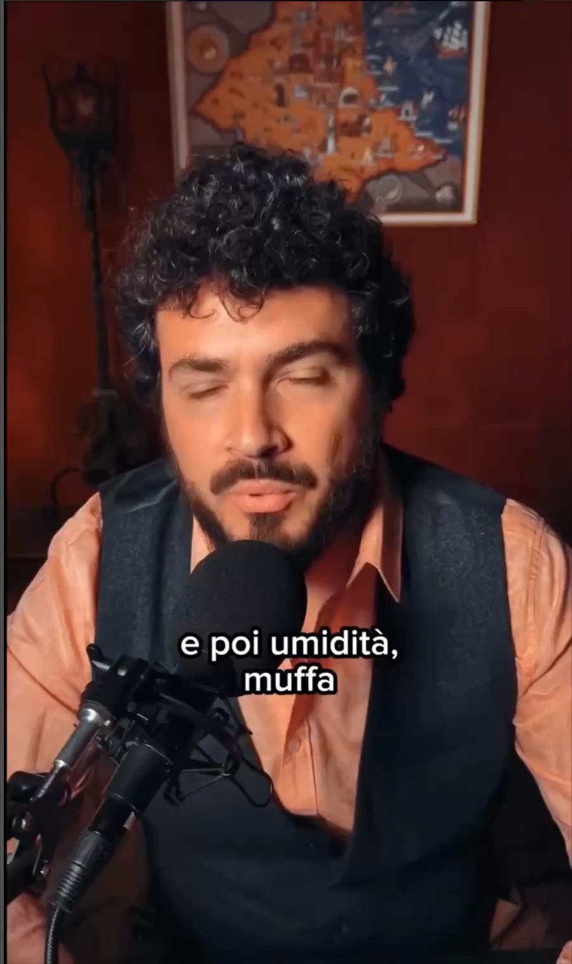
Romagnolo (endangered language)
Climate-related crisis
Collapse and transformation: landscape, language and (ecocultural) identity
Credits: E’ Rumagnulesta

Slide 3
Context and framework
Soukup & Hampton (2021) | “Traumatic crises as revaluation opportunities for stigmatised varieties: Maintaining strength and sense of community with Emilian and Viennese”. NEWCON2020
Hampton & Tufi (forthcoming) | “Centering peripherality as cultural resilience in times of crisis”
Trauma and identity | Duane et al. (2020)
Vulnerability | Tufi (2024); Moriarty (2025) [embodied vulnerability]
Post-traumatic growth | Tedeschi and Calhoun (1996)
Ecolinguistics and LL | Language as heritage and language as land

Slide 4
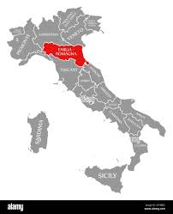
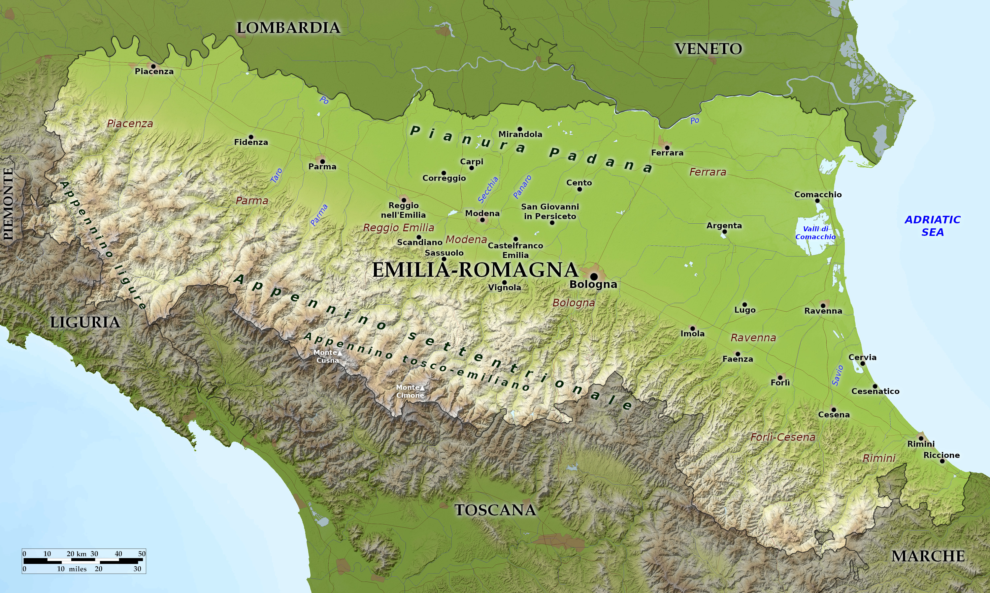
Emilia Romagna
Earthquake 2012
Covid-19 pandemic
Modena Province (Emilia)
National/Global
Floods 2023-24
Romagna

Slide 5
Emilian & Romagnolo
Both Gallo-Romance
Both endangered
Linguistically different
(Coretta et al 2025)
(Vitali 2022)
Culturally different
(Coretta et al 2025)
(Foresti 2010)
Little awareness
High awareness

Slide 6
Trauma and Vulnerability
Trauma as a “blow to the basic tissues of social life that damages the bonds of attaching people together and impairs the prevailing sense of community” (Duane et al. 2020: 1).
Collective trauma can “shatter the core” of community connection
“Often, language is insufficient … to express trauma and pain”
“the SL … provides a means to communicate experiences and emotions when language fails” (Moriarty 2025: 157)
-> Local/endangered languages as a multimodal resource to express trauma
Vulnerability as strength -> agency “embodiment of vulnerability … to explore the intimate relationship between self and society” (164)
-> Local/endangered languages as intimate space
”Vulnerability becomes a source of empathy and a foundation for solidarity” (Tufi 2024: 147)
Not just the semiotic landscape but the language itself is a “vital resource for coping and resilience” (Moriarty 2025: 157)

Slide 7
Post-Traumatic Growth
Tedeschi and Calhoun (1996) introduced the concept of posttraumatic growth (PTG)
central to understanding how suffering can lead to strength and transformation
PTG in the wake of severe crises
where individuals and communities not only recover but are transformed—emerging with reconstructed worldviews, greater resilience, and a new benchmark for future trajectories (Blevins and Tedeschi 2022: 11–12)
Role of narrative in PTG:
Trauma victims embody the “memory of suffering, rage, and pain in a world that longs to forget”
coping with social pain as crucial as addressing individual wounds
trauma is often transmitted intergenerationally through silence and secrecy (Možina and Erzar (2021: 118)
Narratives allow us to participate in the suffering of others
narratives as “infrastructuring of vulnerability [for] engender[ing] future imaginings” (Tufi 2024: 150)

Slide 8
Language as Heritage and Land
Language as Heritage: not static relics, but living systems of continuity, identity, and interdependence (Hampton and Buckingham, forthcoming)
Language as Land: Indigenous/local languages inseparable from place; anchors of knowledge and belonging (Chiblow and Meighan 2022)

Slide 9
when the “conspiracy of silence is broken”, narratives of suffering may unleash a mixture of guilt, shame, denial, and compassion that reverberates across individuals and communities alike (Možina and Erzar 2021: 110)
Notes:
I argue that there is no narrative for ER and that traumas expose this underlying collective suffering through the umbilical cord (the local language)

Slide 10
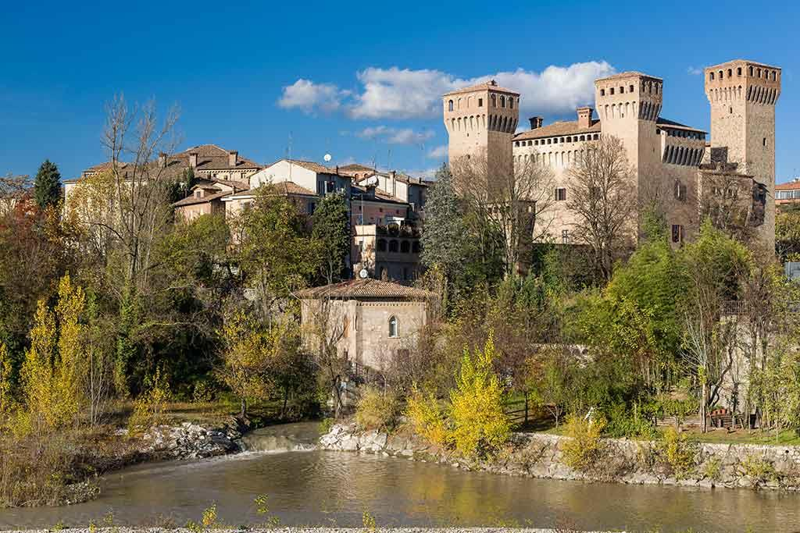
Vignola

Slide 11
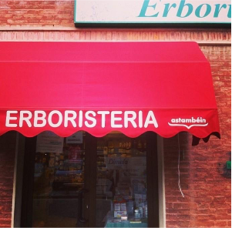

Slide 12
A stam béin
2012 Earthquake
(Astambéin – “We are well”)
Origin: Branding project (2007) with Emilian name, initially for urban design/commerce.
Post-earthquake revival: local shops re-used logo → re-semioticised as stoic resilience.
Collective survival strategy, transforming a market slogan into a community healing narrative.

Slide 13
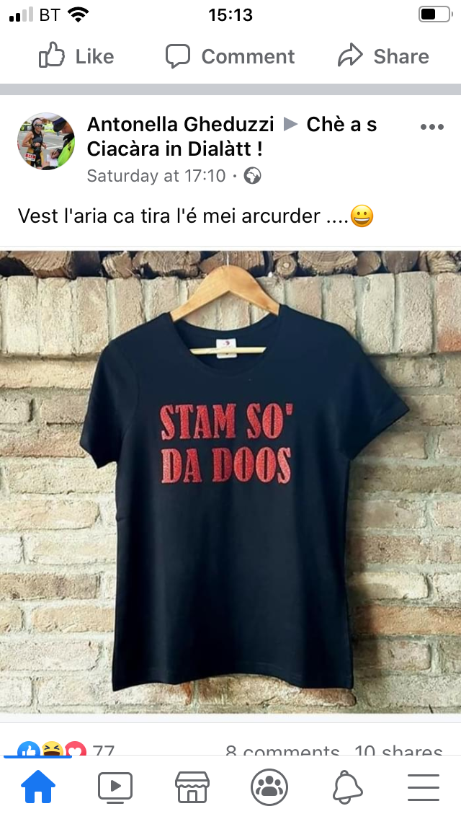
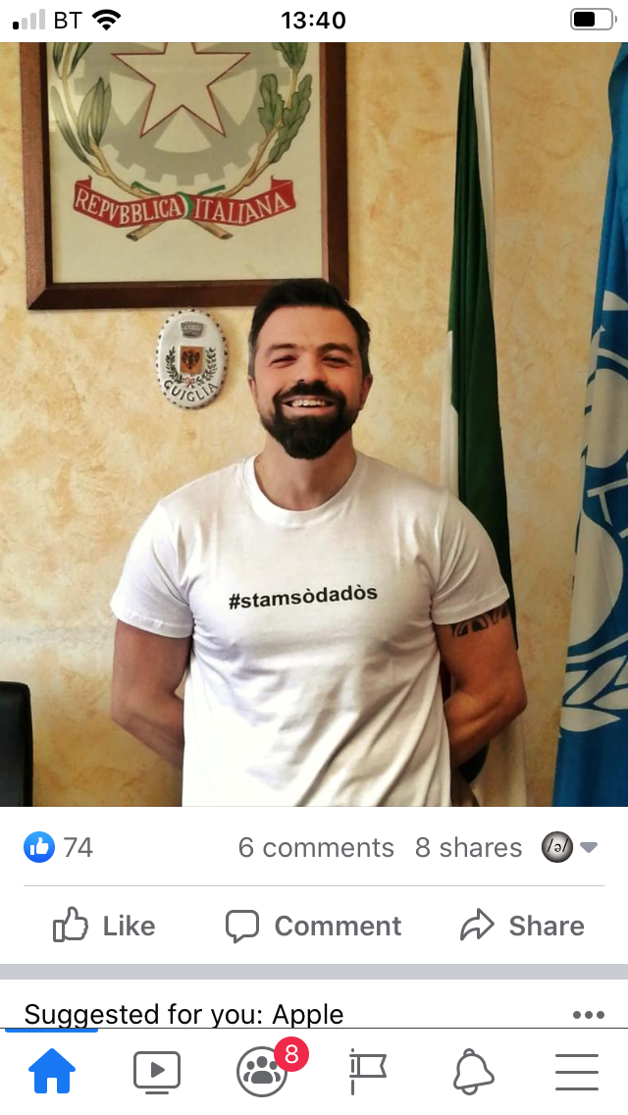
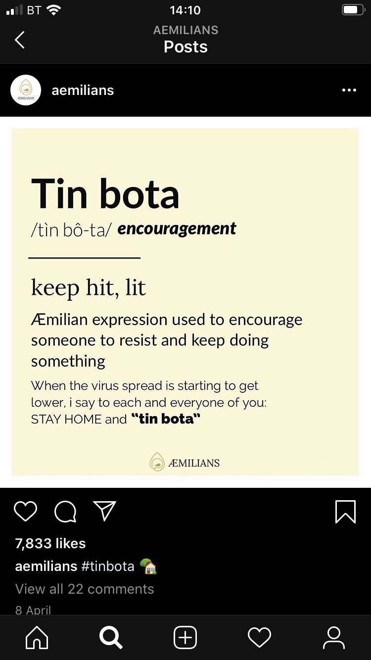

Slide 14
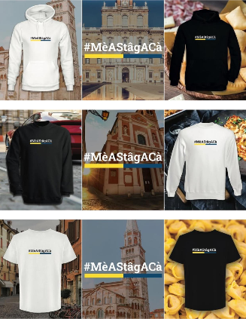

Slide 15
Mè a stâg a cà
COVID-19
(Mè A Stâg A Cà – “I’m staying home”)
Instagram campaign: hoodies/jumpers in Emilian sold to fund hospitals -> virtue
Semiotics: combined food icons (gnocco fritto, tortellini), Modena’s architecture, Ferrari, and Modena colours → local pride.
Emilian = comforting and intimate language, mobilising trust in institutions and embodied responsibility
(wearing language = acting collective care)

Slide 16
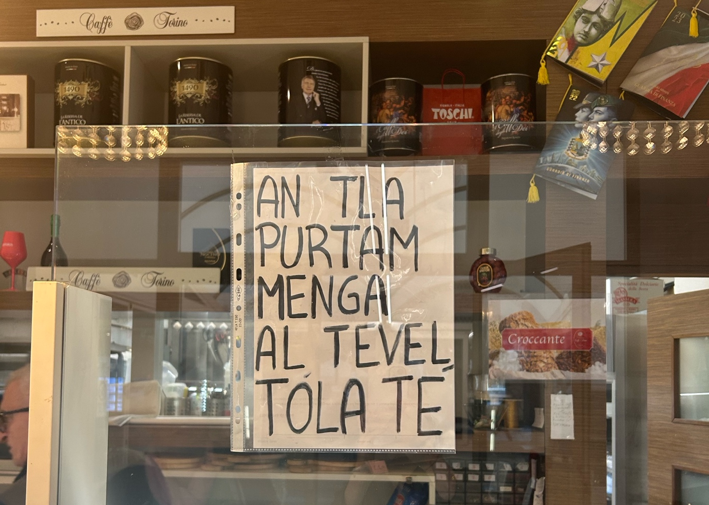
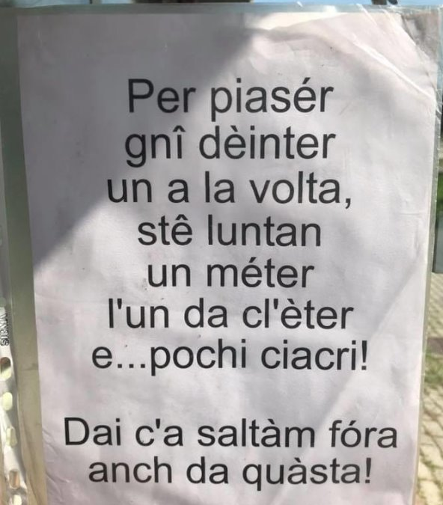

Slide 17
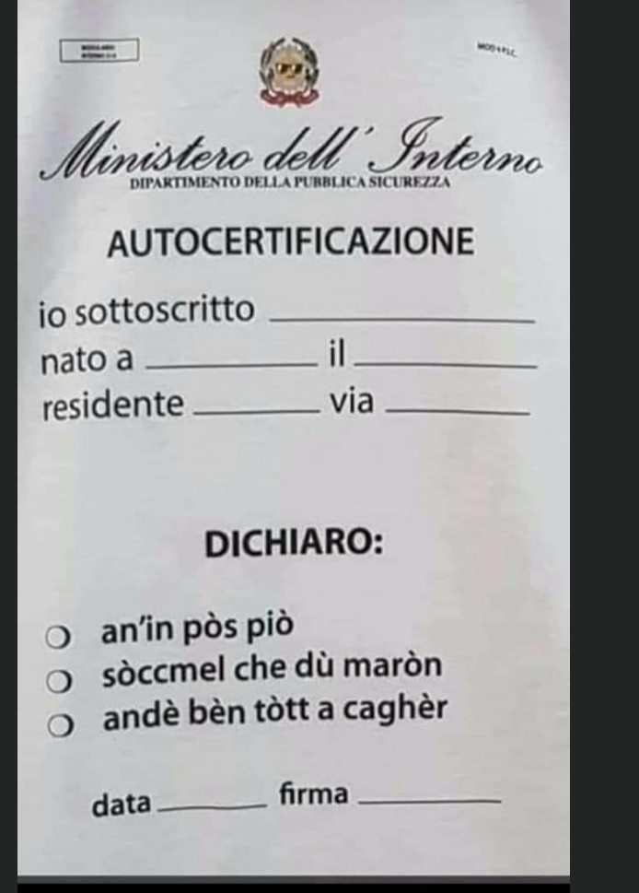

Slide 18
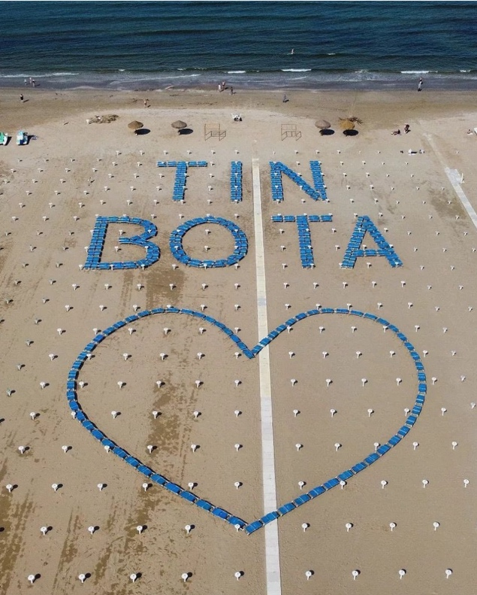

Slide 19
Tin bota
2023 Floods
(Tin bota – “Hang in there”)
Rimini beach club sunbeds arrangement
Local language on landscape = visible resilience, framing hope as communal rather than individual, rooted in place identity.
Emilian and Romagnolo convey/embody the vulnerability that transforms into resistance (“performative agency” Butler 2016)
Land is the wound/sufferance – the site of vulnerability and resistance, it is the community
Language as land -> Tin bota -> skinscape (Peck and Stroud 2015) of the community for solidarity and resistance -> embodied vulnerability (Moriarty 2025)

Slide 20
Conclusions
A stam béin | Mè a stâg a cà | Tin bota
Resemioticised branding (public) Stoicism Mutual aid through supporting local businesses | Fundraising campaign (virtuous) Online and “private space” Solidarity and civic responsibility | Communicating through the beach Hope Collective resilience
Crises strip away hegemonic logics, revealing interdependence Endangered/local languages as resources for future survival & collective healing For Emilian and Romagnolo a narrative is needed to deal with the trauma and lead to PTG (language revitalisation)

Slide 21
—E’ Rumagnulesta
It is beautiful to end inside a colour.
And I too ended up inside that green,
The river that swallowed me.
It came looking for me, It took me,
And it spat me back out,
A little greener.
“L e’ bël fni int un culōr
E a so fni indẽtr a che’ vērd nẽca me
Ch’u m ha magnê e’ fiõ
U m è vnu a zarchê, u m ha ciap
E u m ha arspudê fura
Un pô piò vērd”

Slide 22
References
Blevins, Cara, and Richard Tedeschi. 2022. ‘Posttraumatic Growth & Wisdom: Processes and Clinical Applications.’ In Post-Traumatic Growth to Psychological Well-Being: Coping Wisely with Adversity, edited by Melanie Munroe and Michel Ferrari, vol. 30. Lifelong Learning Book Series. Springer International Publishing. Butler, Judith (2016). Rethinking Vulnerability and Resistance. In Judith Butler, Seynep Gambetti & Leticia Sabsay (Eds). Vulnerability in Resistance (pp. 2–27). Durham, NC: Duke University Press.
Chiblow, Susan, and Paul J. Meighan. 2022. ‘Language Is Land, Land Is Language: The Importance of Indigenous Languages’. Human Geography 15 (2): 206–10. https://doi.org/10.1177/19427786211022899.
Coretta, Stefano, Simone De Cia, and Jessica Hampton. 2025. A Vitality Assessment of Gallo-Romance of Northern Italy. https://doi.org/10.31219/osf.io/fuzby.
Duane, Addison M., Kimberly L. Stokes, Christina L. DeAngelis & Erika L. Bocknek. 2020. ‘Collective Trauma and Community Support: Lessons from Detroit.’ Psychological Trauma: Theory, Research, Practice, and Policy 12 (5): 452–54. 2020-41462-001. https://doi.org/10.1037/tra0000791.
Foresti, Fabio. 2010. Profilo Linguistico Dell’Emilia-Romagna. Vol. 298. Laterza.
Hampton, Jessica & Denéa Buckingham. forthcoming. ‘Redefining Language, Identity, and Heritage through an Ecolinguistic Lens’. In The Bloomsbury Handbook of Ecolinguistics, edited by Robert Poole, Daniela Francesca Virdis, Jessica Hampton, and Amir Ghorbanpour. Bloomsbury.
Moriarty, Máiréad. 2025. ‘Embodied Vulnerability: Semiotic Landscapes of Suicide’. Linguistic Landscape. 11 (2): 156–71
Možina, Katarina, and Katarina Kompan Erzar. 2021. ‘Trauma and Community’. Journal of Nationalism, Memory & Language Politics 15 (1): 109–29.
Peck, Ameina & Christopher Stroud (2015). Skinscapes. Linguistic Landscape, 1(1–2), 133–151.
Tedeschi, Richard G., and Lawrence G. Calhoun. 1996. ‘The Posttraumatic Growth Inventory: Measuring the Positive Legacy of Trauma’. Journal of Traumatic Stress 9 (3): 455–71.
Tufi, Stefania. 2024. ‘Borderscapes’. In The Bloomsbury Handbook of Linguistic Landscapes, edited by Robert Blackwood, Stefania Tufi, and Will Amos. Bloomsbury Publishing.
Tufi, Stefania. 2025. ‘Sharing the Vulnerable Self: LL Constructions of Narratives of Suffering’. Linguistic Landscape. An International Journal 11 (2): 135–55.

Slide 23
Thanks!
Let’s keep in touch
jhampton@Liverpool.ac.uk
jesshampton.github.io

Slide 25
...and our sets of editable icons
You can resize these icons without losing quality.
You can change the stroke and fill color; just select the icon and click on the paint bucket/pen.
In Google Slides, you can also use Flaticon’s extension, allowing you to customize and add even more icons.

Slide 26
Nature Icons

